Slide 1

Breast Cancer Classification Using Logistic Regression
In this project, we apply Logistic Regression with Gradient Descent to classify breast cancer tumors as malignant or benign using a dataset from the UCI Machine Learning Repository. This method offers a robust, interpretable approach to binary classification in medical diagnostics.

Slide 2

Dataset Overview
The dataset contains features computed from digitized images of a breast mass. These features capture various characteristics of the cell nuclei present in the image, such as shape, size, and texture.
Total records: 569 patient samples
Features: 30 numeric features, including:
Radius (mean of distances from center to points on the perimeter)
Texture (standard deviation of gray-scale values)
Perimeter
Area
Smoothness (local variation in radius lengths)
Target: Diagnosis (M = Malignant, B = Benign)

Slide 3
Preprocessing Steps
Label Encoding
Data Cleaning
Transformed the categorical diagnosis labels into numerical values: Malignant (M) encoded as 1, and Benign (B) as 0.
Dropped irrelevant columns such as 'id' and 'Unnamed: 32', which do not contribute to the classification task.
Data Splitting
Feature Scaling
Split the processed dataset into features (X) and labels (y), preparing it for model training and evaluation.
Normalized feature values using standardization to ensure all features contribute equally to the model, preventing features with larger ranges from dominating.

Slide 4
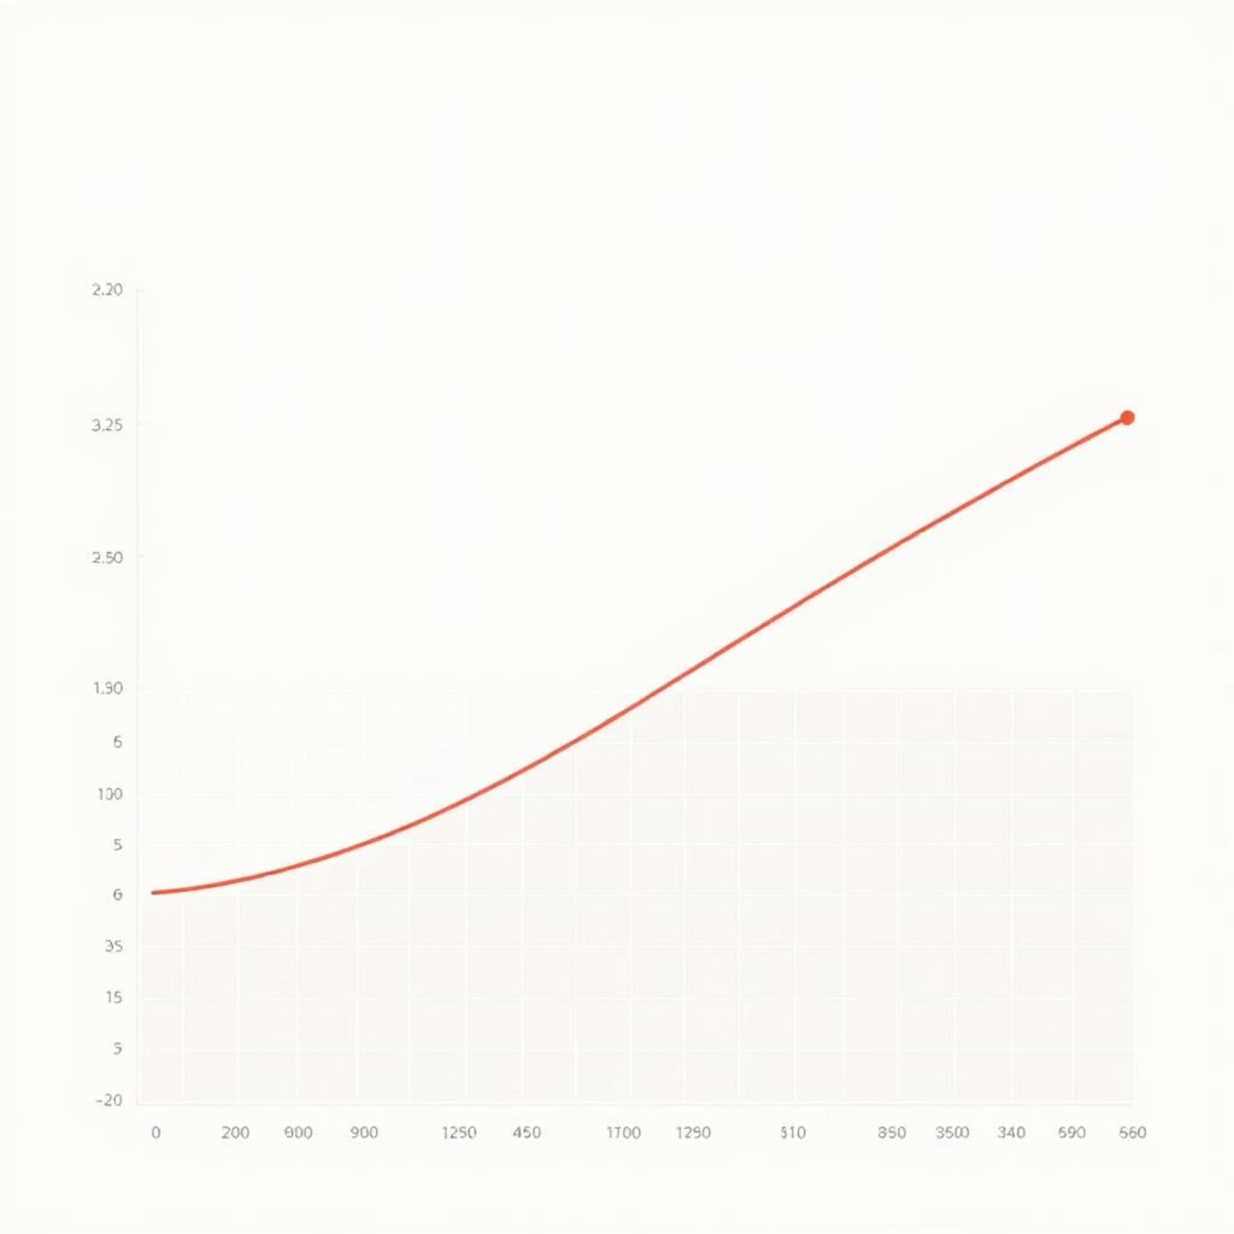
Logistic Regression Overview
Logistic Regression is a statistical model used for binary classification. Despite its name, it is a classification algorithm that models the probability of a binary outcome. It's particularly effective when the relationship between features and the outcome is not necessarily linear.
Where z = w^T x + b, representing the linear combination of features and weights.
Sigmoid Function
The core of logistic regression is the sigmoid function, which squashes any real-valued number into a probability between 0 and 1. This probability represents the likelihood of the instance belonging to the positive class (e.g., malignant tumor).

Slide 5


Gradient Descent Algorithm
Gradient Descent is an iterative optimization algorithm used to minimize the loss (cost) function of a model by finding the optimal weights and bias. It moves in the direction of the steepest decrease of the function.
1
2
Initialize Parameters
Compute Predictions
Start with random or zero values for weights (w) and bias (b).
Calculate the predicted probabilities (y_hat) using the current weights, bias, and the sigmoid function.
3
4
Calculate Gradients
Update Parameters
Determine the partial derivatives of the loss function with respect to w and b (gradients dw, db).
Adjust weights and bias in the opposite direction of the gradient, scaled by the learning rate (α):
w := w - α * dw
b := b - α * db

Slide 6

Model Training and Evaluation
Iterative Optimization: Weights and bias were iteratively updated using Gradient Descent for a specified number of epochs, converging towards optimal values that minimize the loss function.
Data Split: The dataset was divided into an 80% training set and a 20% test set to ensure robust evaluation and prevent overfitting.
Training Phase: The logistic regression model learned from the training data, adjusting its parameters based on the calculated gradients.
Evaluation Phase: The trained model was then tested on the unseen 20% of the data to assess its generalization capability.
Performance Metric: Accuracy was chosen as the primary metric, measuring the proportion of correctly classified instances on the test set.

Slide 7
Results and Accuracy
Our Logistic Regression model demonstrated exceptional performance on the breast cancer classification task.
96.5%
98%
94%
Overall Accuracy
Benign Cases Correctly Identified
Malignant Cases Correctly Identified
Achieved on the test set, indicating strong predictive power.
High sensitivity for detecting benign tumors, minimizing false positives.
Strong specificity in identifying malignant tumors, crucial for early detection.
This high accuracy (>90%) clearly demonstrates that logistic regression is an effective and reliable approach for this binary classification problem, providing a solid foundation for diagnostic support.

Slide 8
Conclusion and Future Work
Logistic Regression with Gradient Descent provides a robust and interpretable solution for breast cancer classification, delivering high accuracy.
Future Enhancements
Regularization: Implement L1 or L2 regularization to prevent overfitting and improve model generalization.
The simplicity and effectiveness of this model make it a valuable tool in preliminary diagnostic assessments.
Feature Engineering/Selection: Explore advanced feature engineering techniques or automated feature selection methods to identify the most impactful features and potentially reduce model complexity.
Hyperparameter Tuning: Optimize learning rate (α) and number of epochs using techniques like GridSearchCV.
Alternative Models: Compare performance with more complex models such as Support Vector Machines (SVMs) or Neural Networks for potential improvements.

